Slide 1

React
Redux

Slide 2
React - 2013
UI management JS open-source library (UI model like JS object to DOM)
Maintained by Facebook
Rendering and event handling
Novel ideas:
- Influence from functional programming
- One-way data flow
- Virtual DOM
- Vanilla JS for templating
Declarative
Composable components

Slide 3
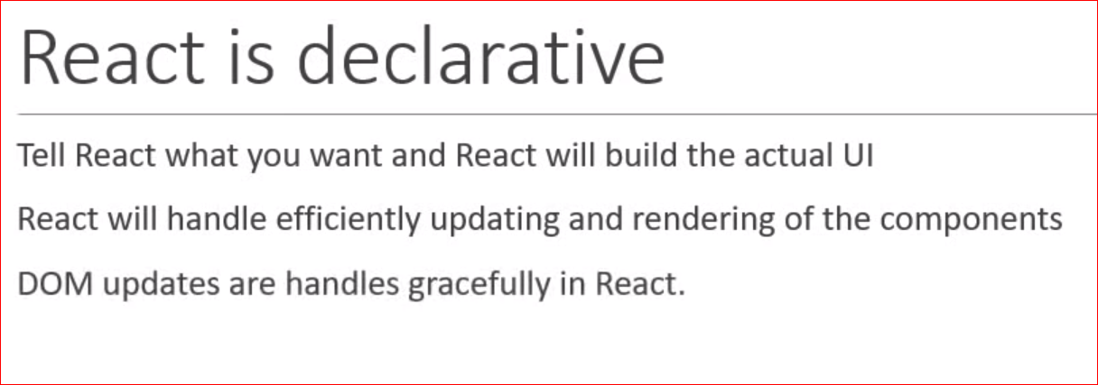

Slide 4
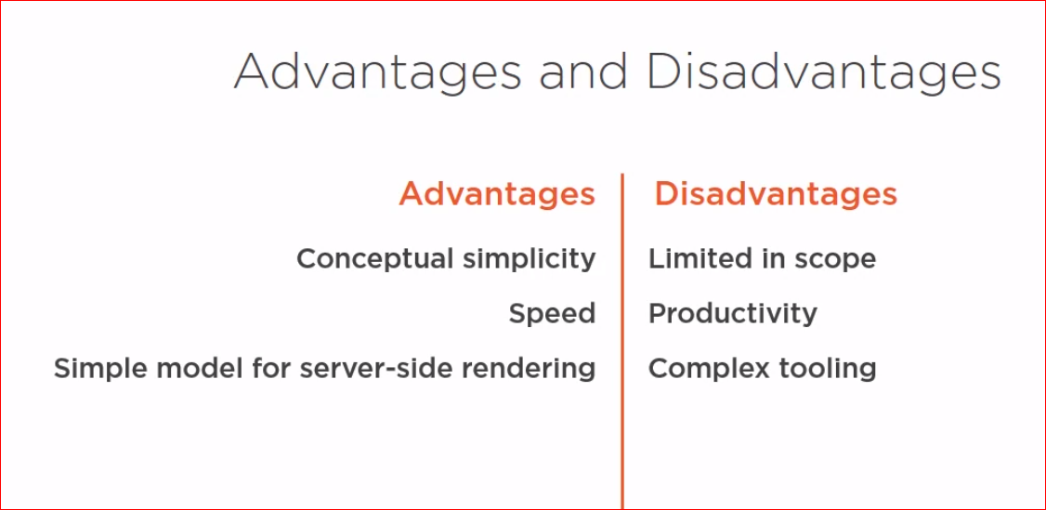

Slide 5
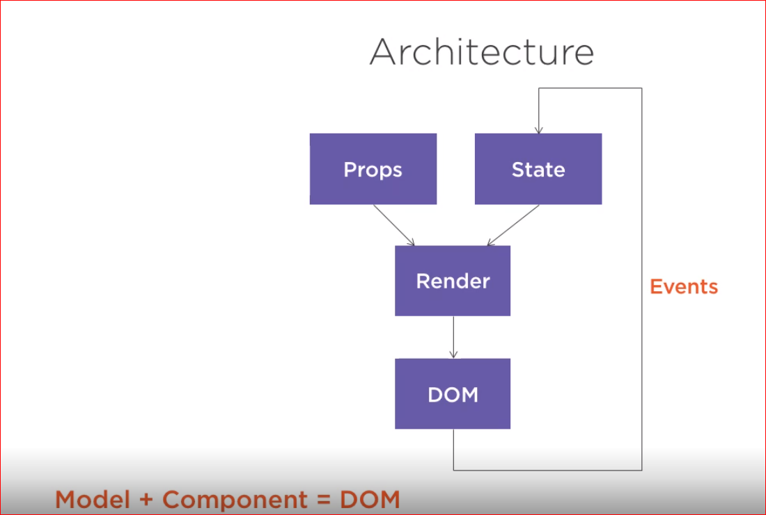

Slide 6
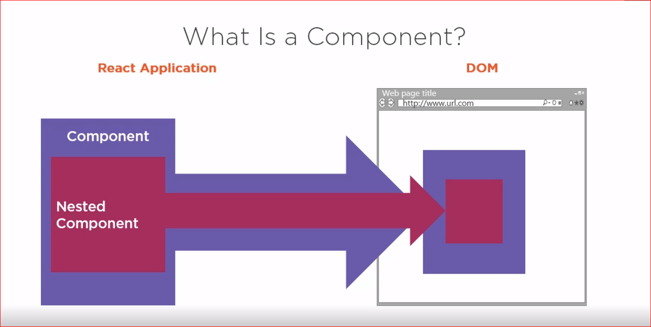

Slide 7
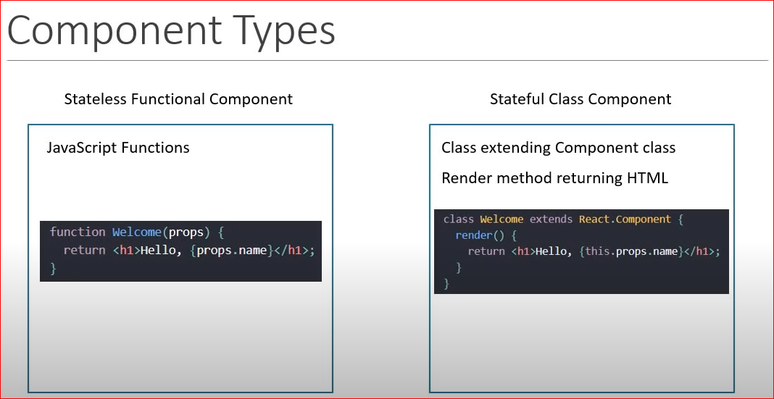

Slide 8
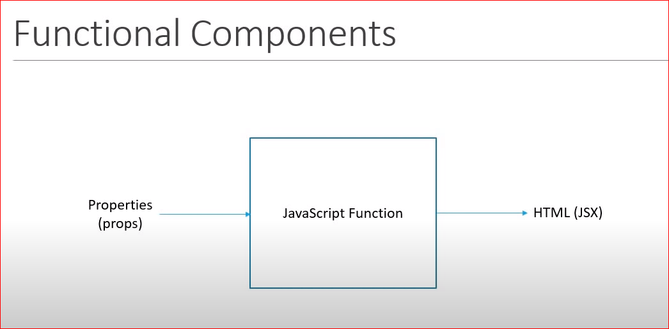

Slide 9
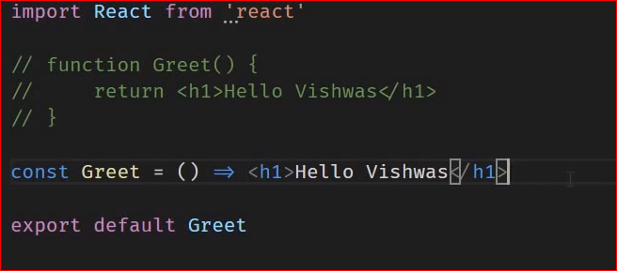

Slide 10
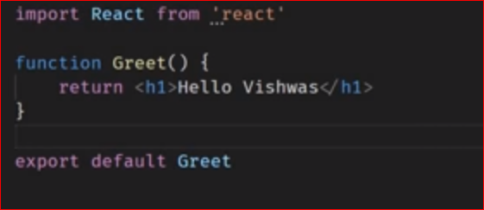

Slide 11
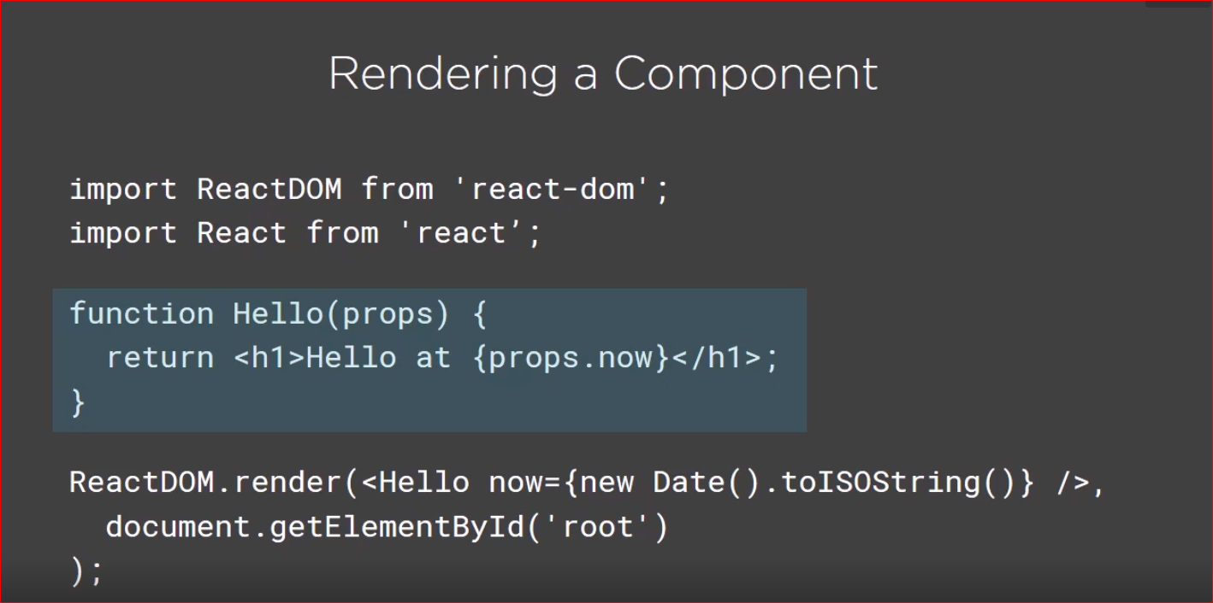

Slide 12
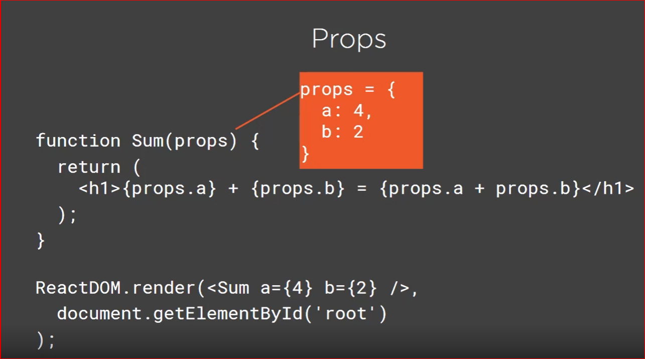

Slide 13
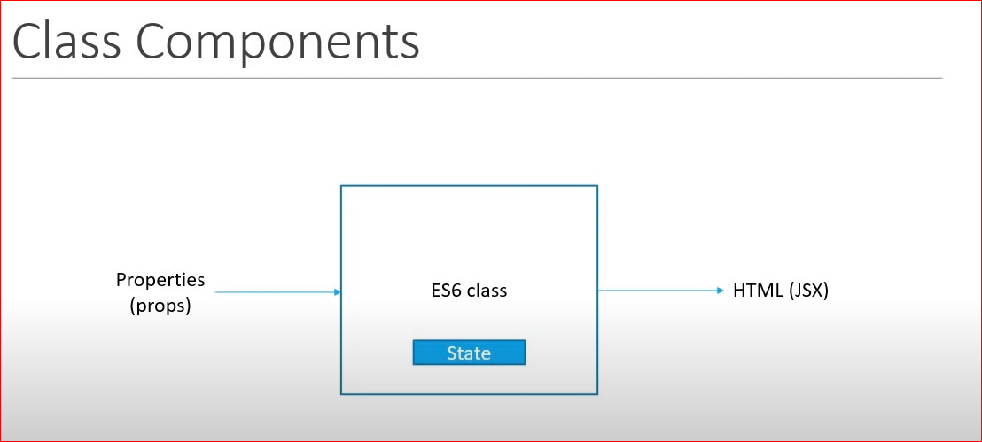

Slide 14
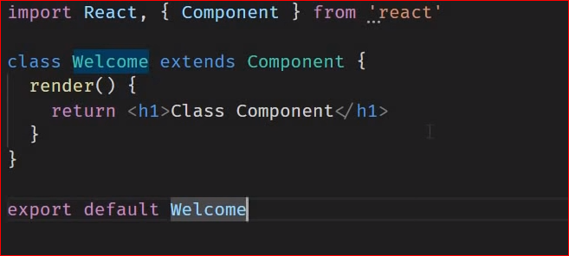

Slide 15
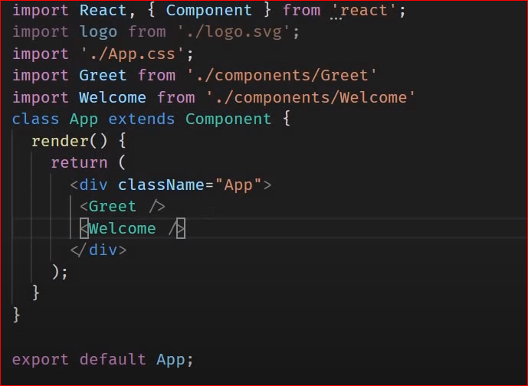

Slide 16
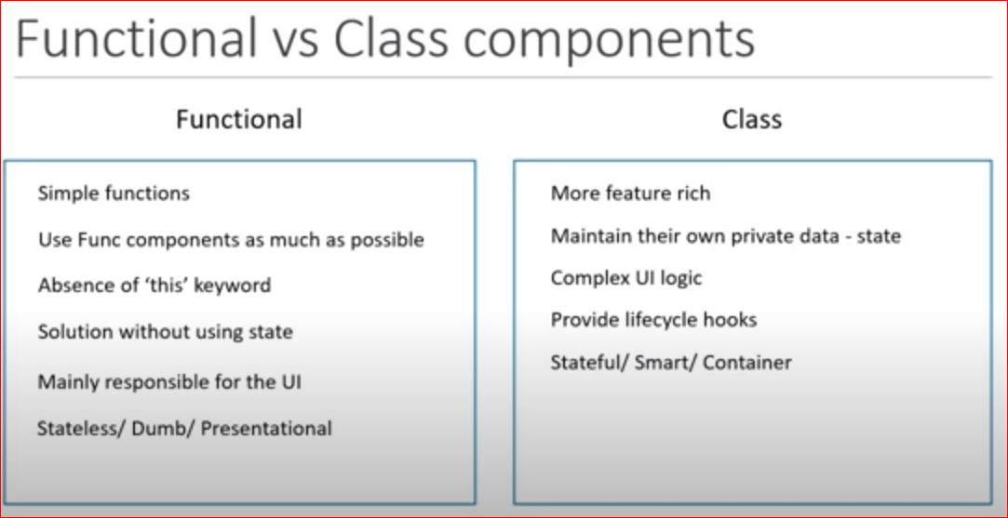

Slide 17
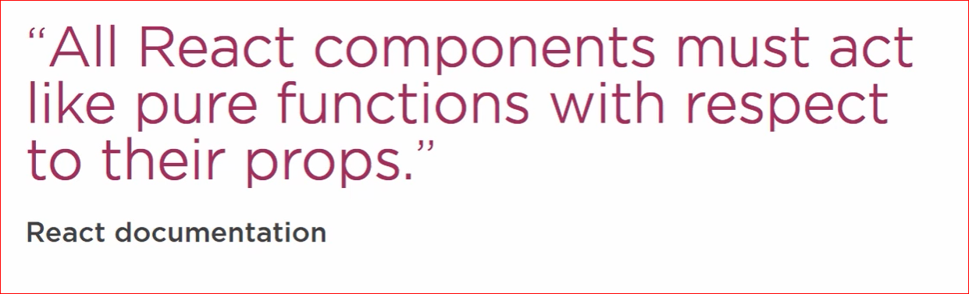

Slide 18
Get start readme
GitHub - facebook/create-react-app: Set up a modern web app by running one command.
npm install –g create-react-app
create-react-app <project-name>
npm start

Slide 19
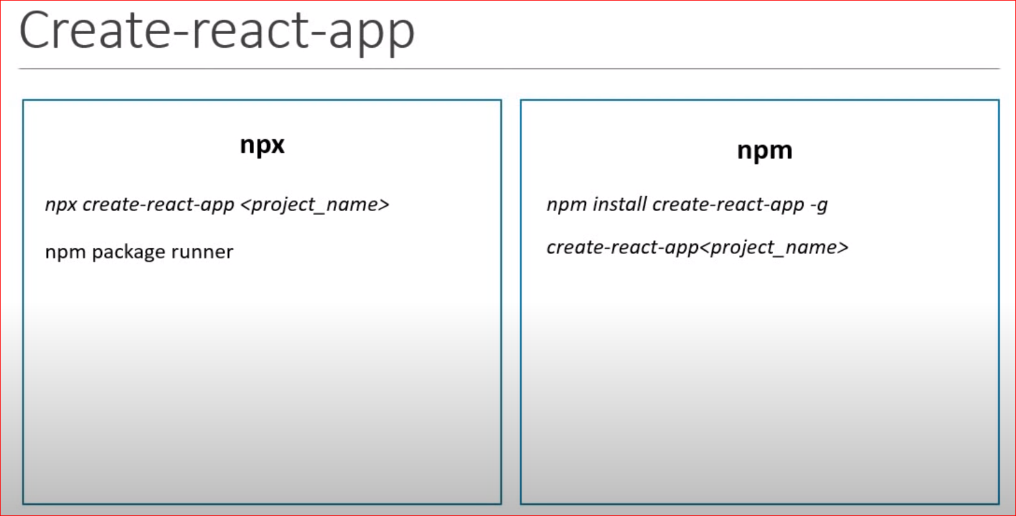

Slide 20
Redux

Slide 21
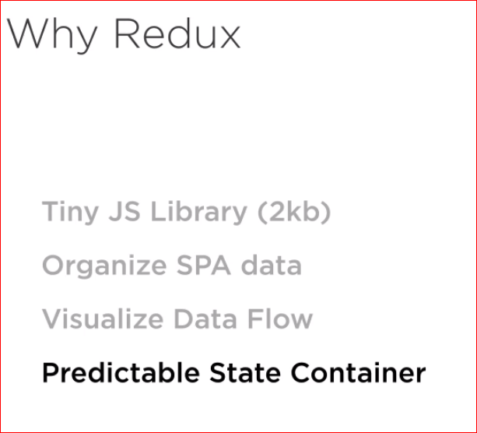

Slide 22
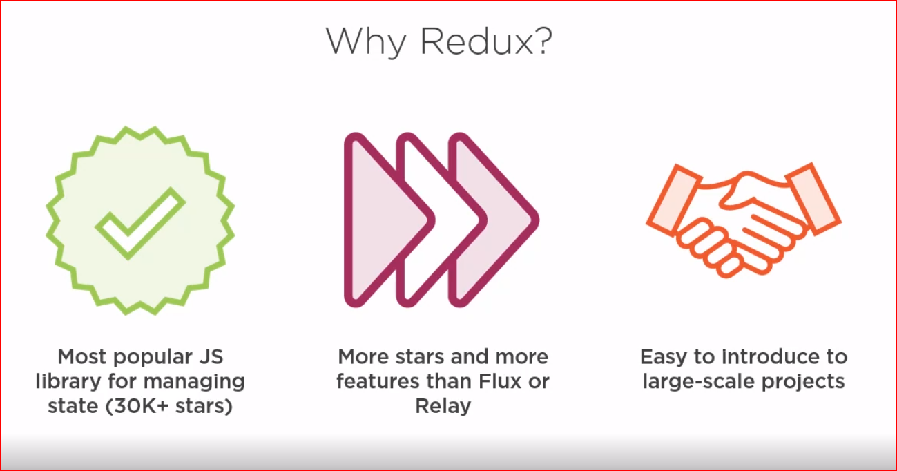

Slide 23
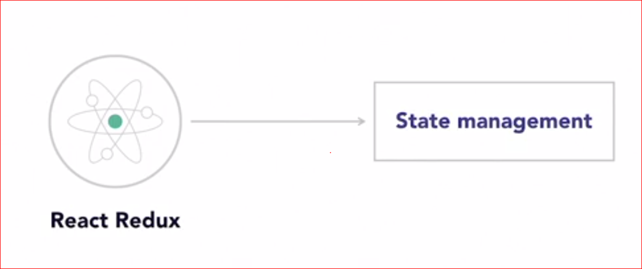

Slide 24
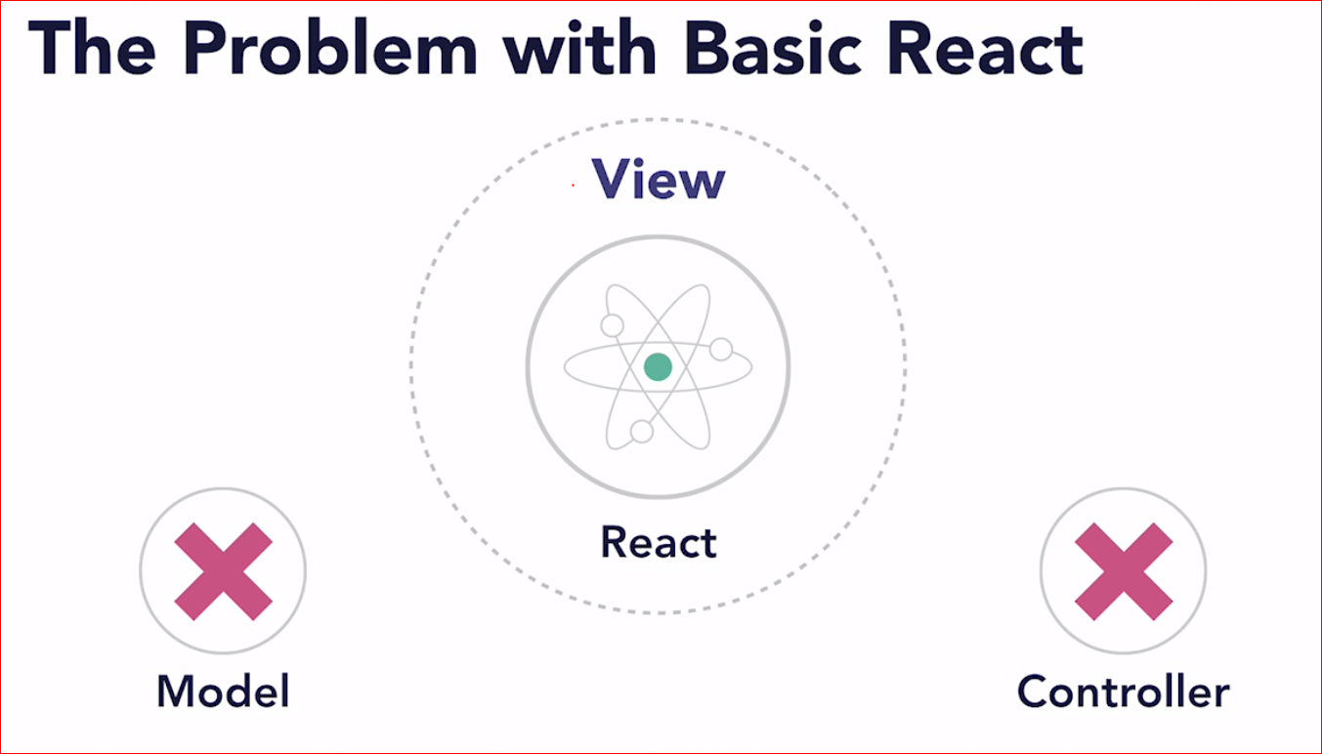

Slide 25
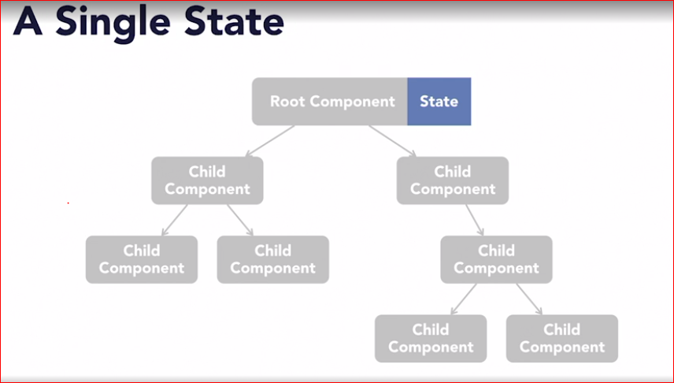

Slide 26

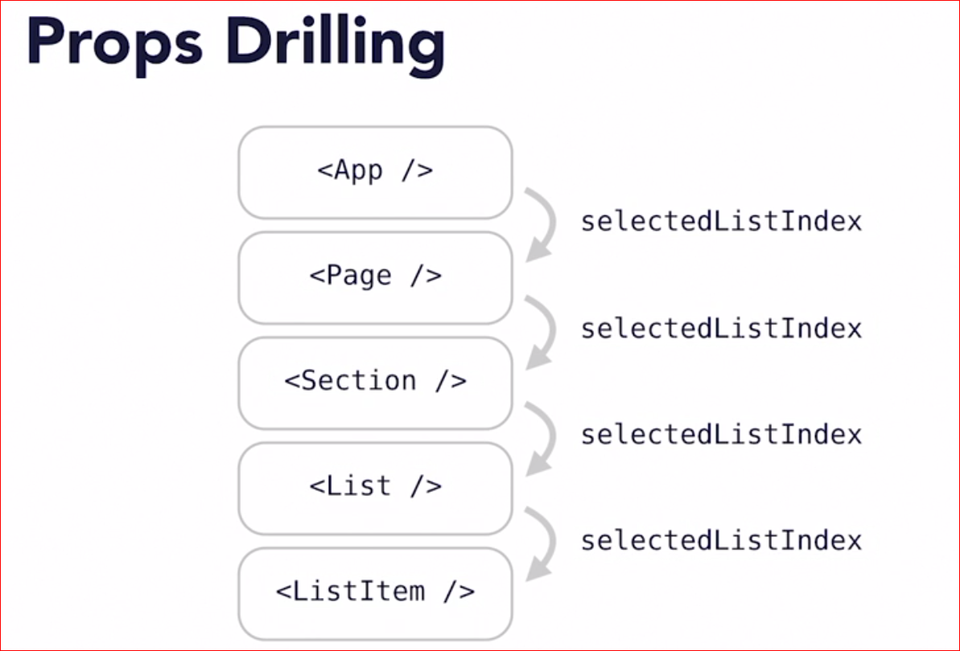




Slide 27
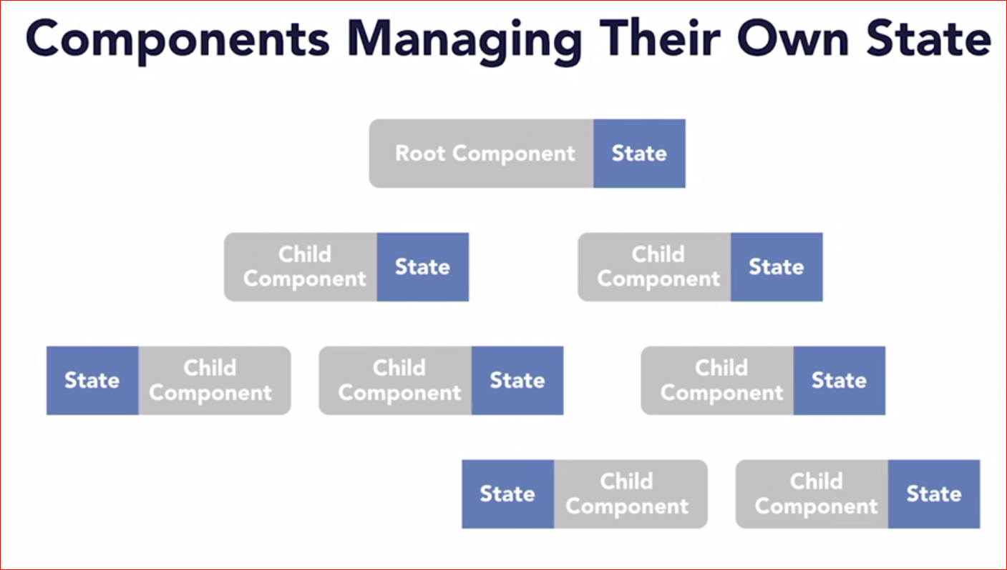

Slide 28
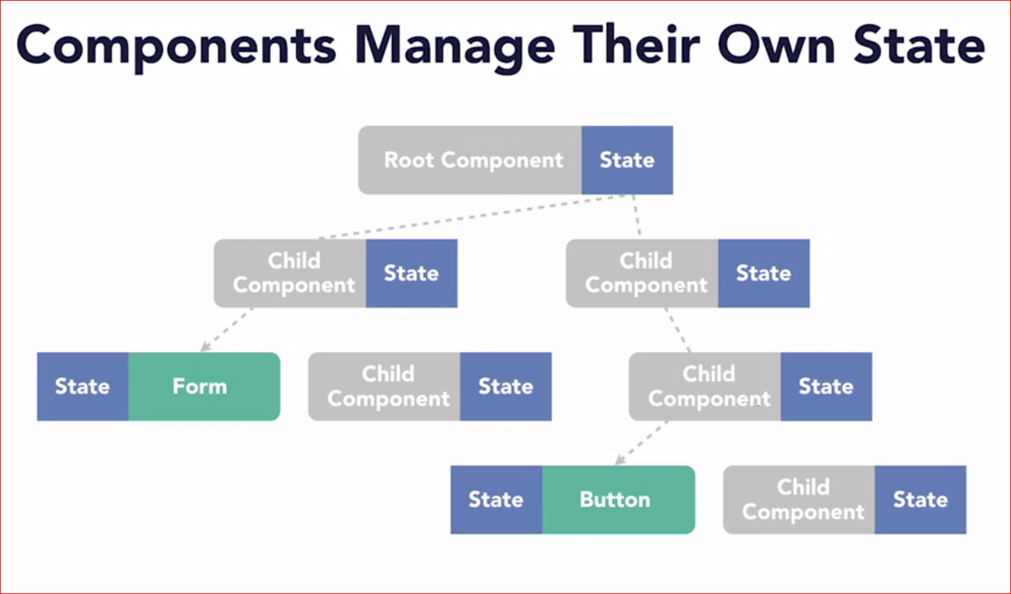

Slide 29
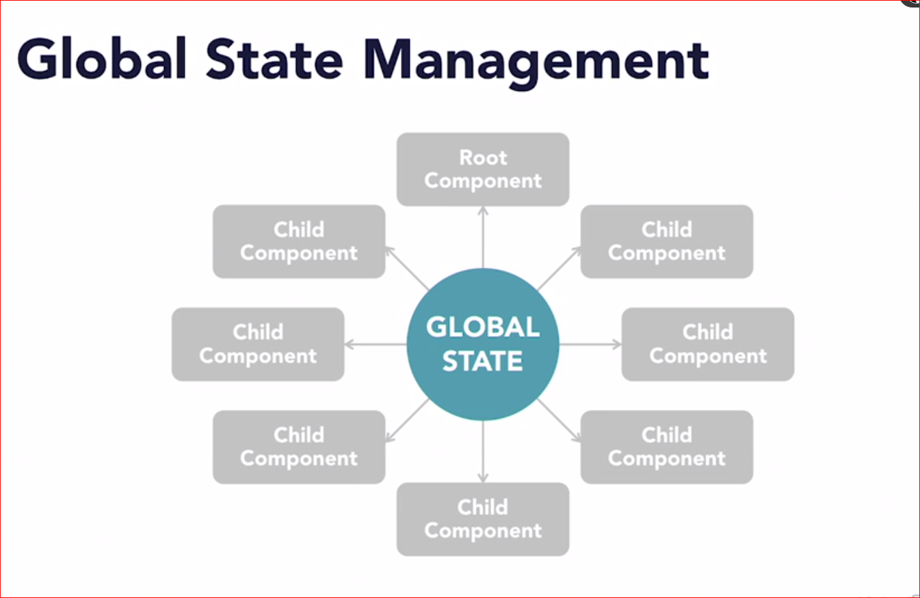

Slide 30


Slide 31
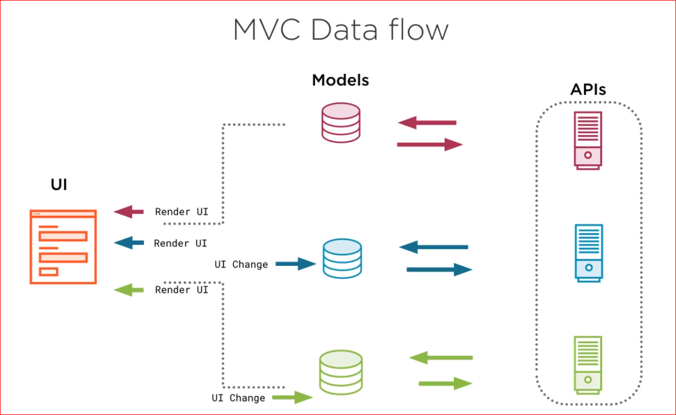

Slide 32
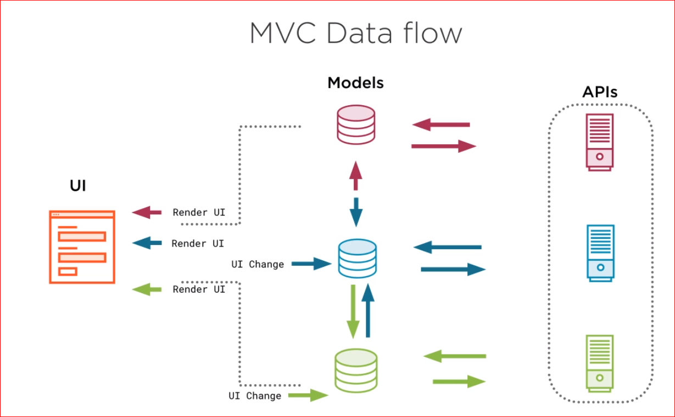

Slide 33
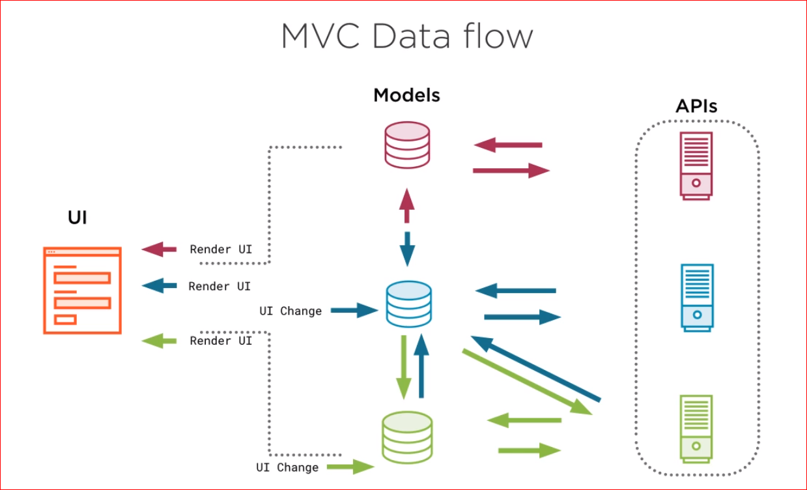

Slide 34
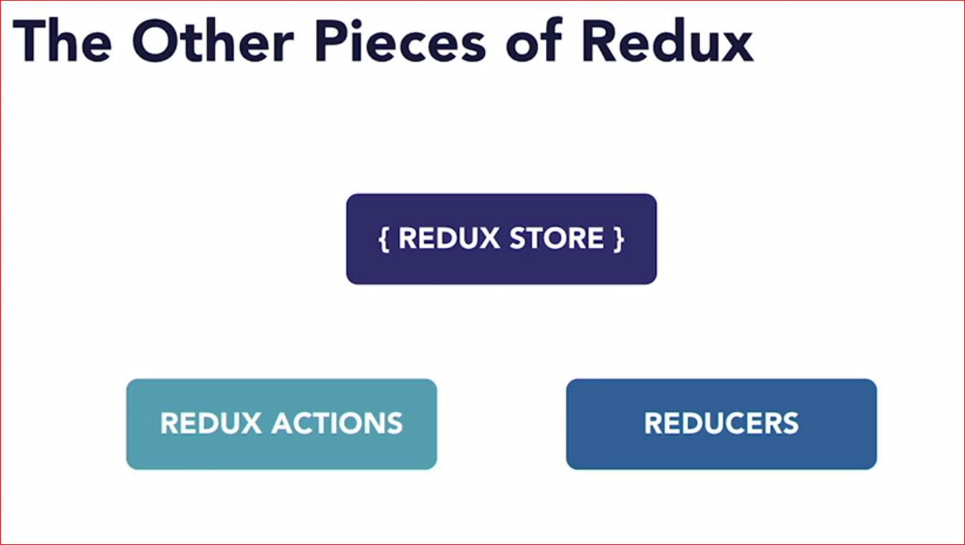

Slide 35
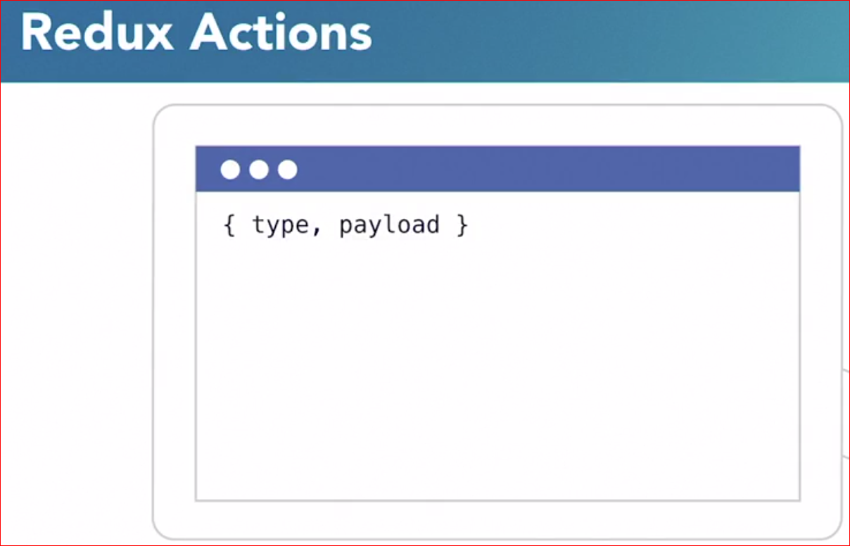

Slide 36
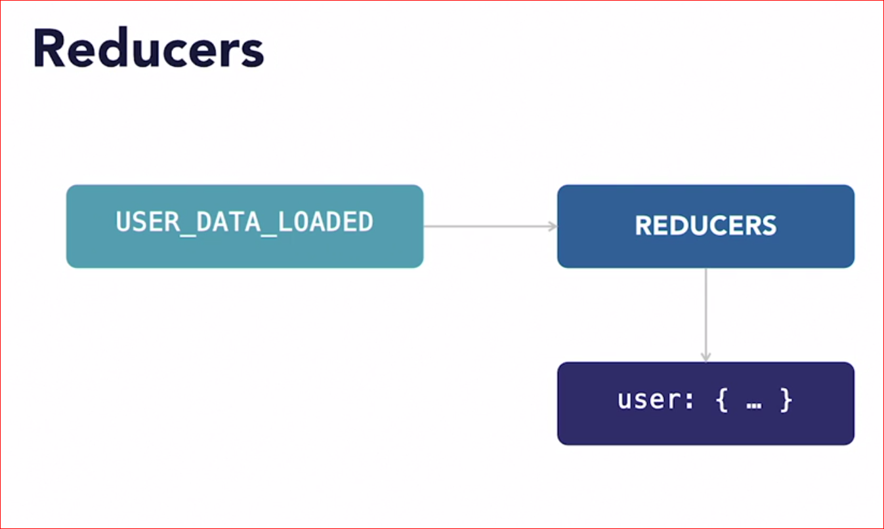

Slide 37
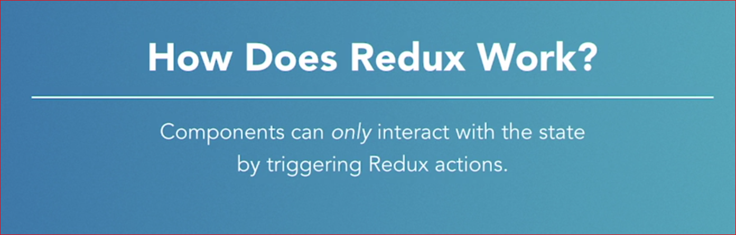

Slide 38
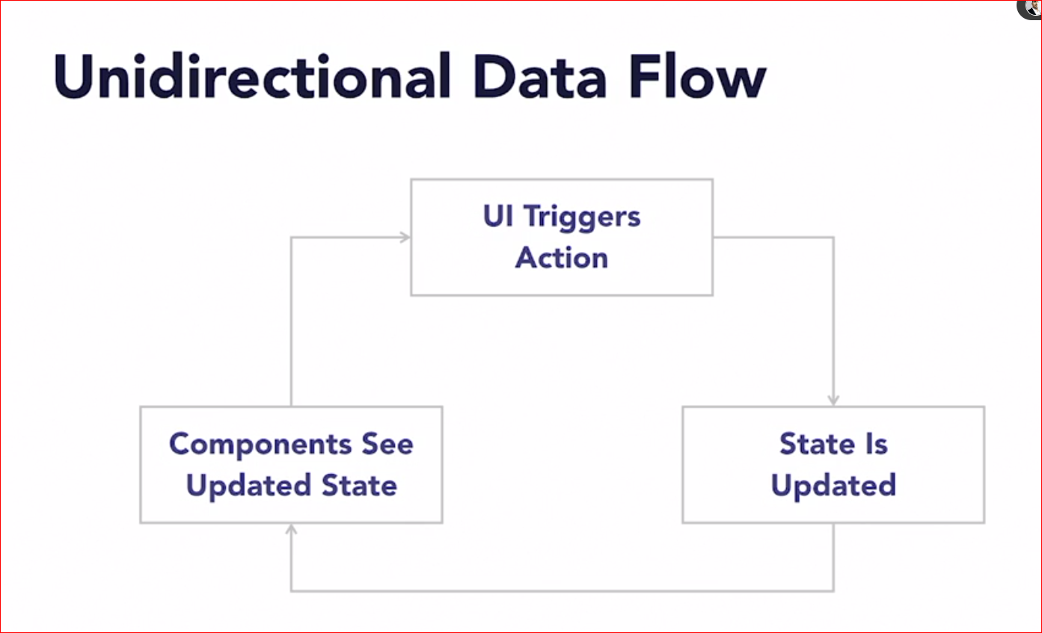

Slide 39
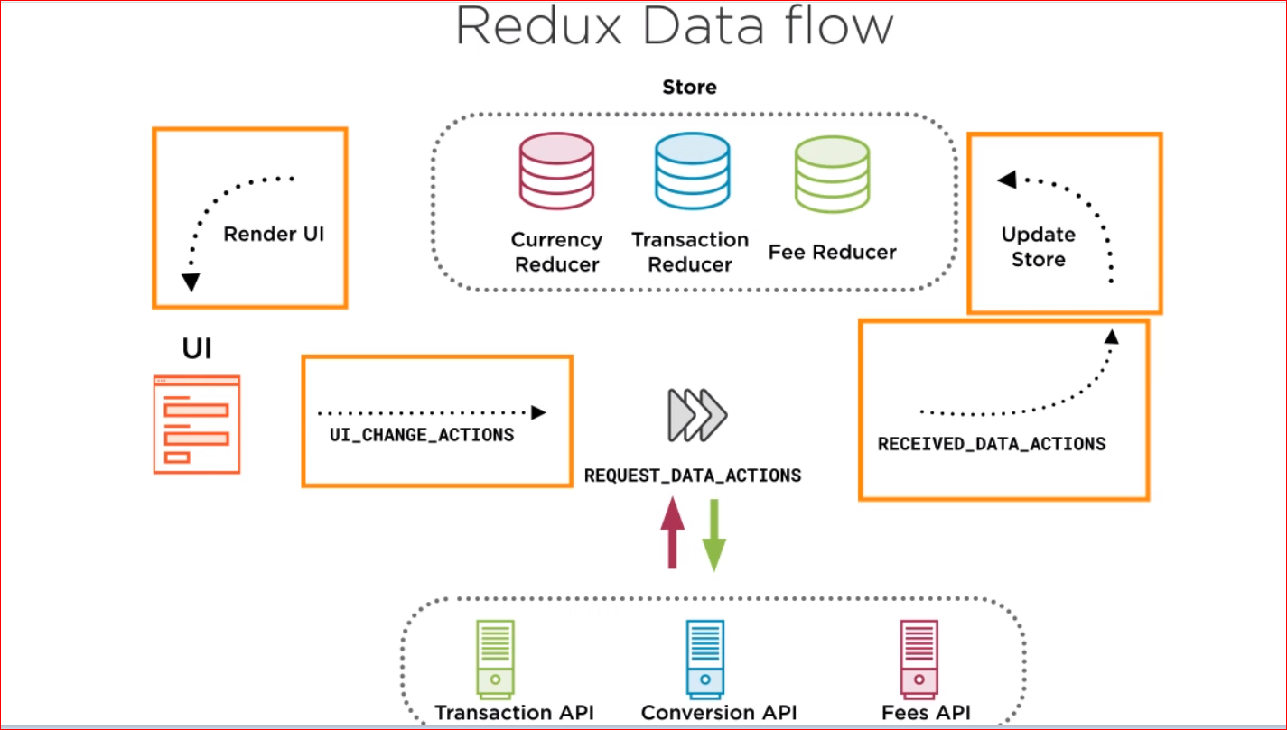

Slide 40


Slide 41


Slide 42


Slide 43
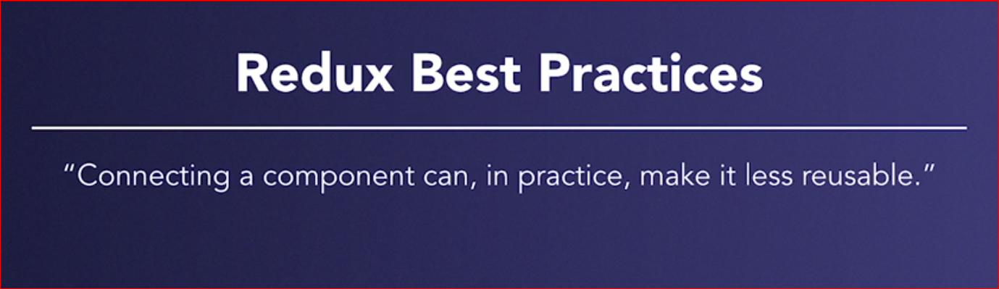

Slide 44
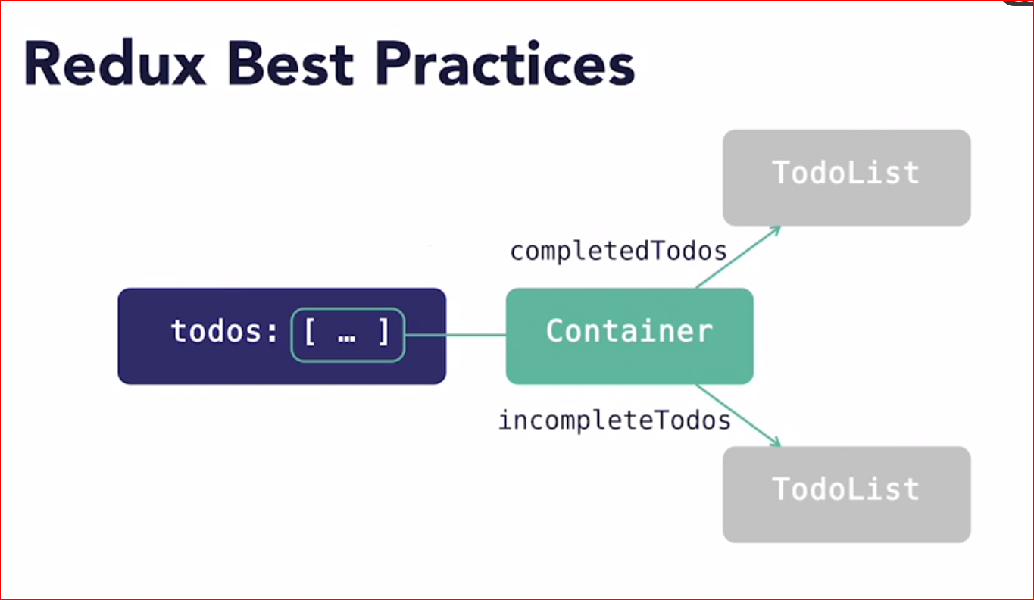

Slide 45
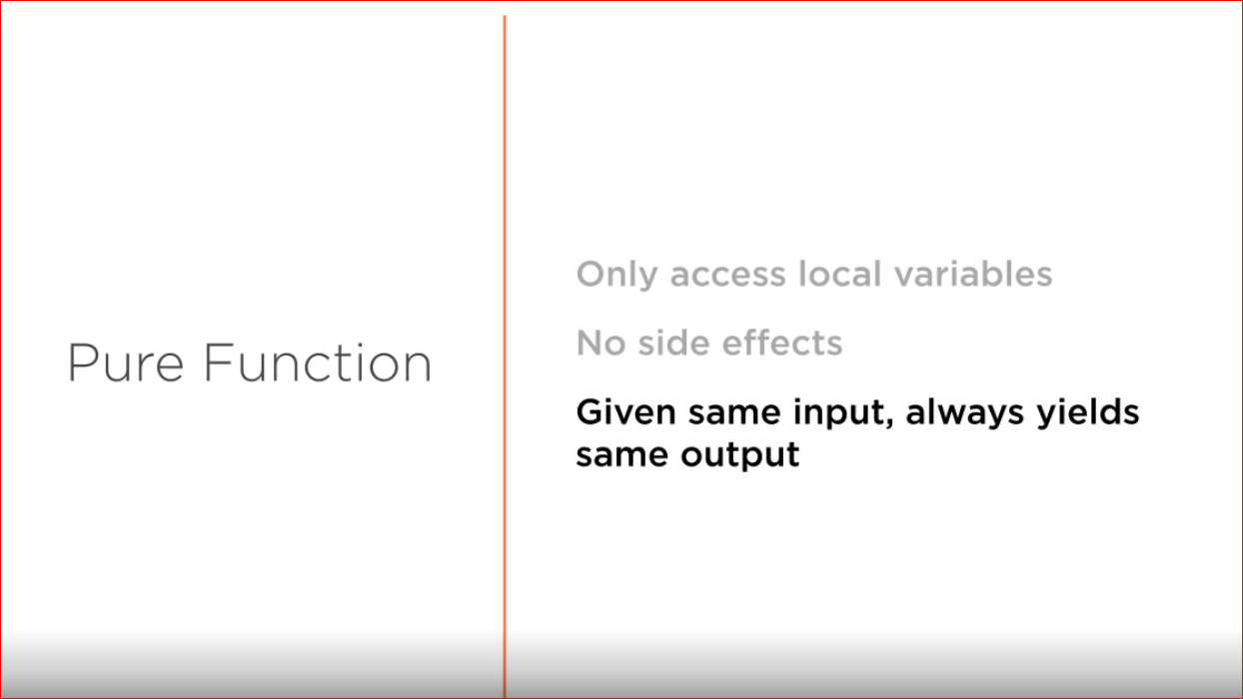

Slide 46
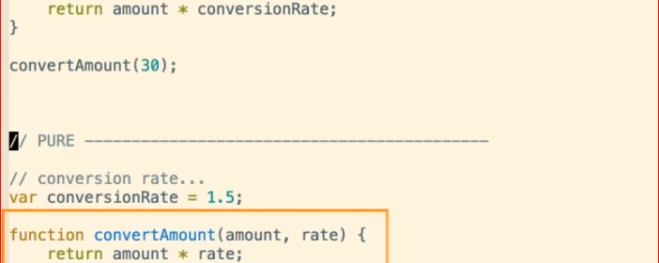
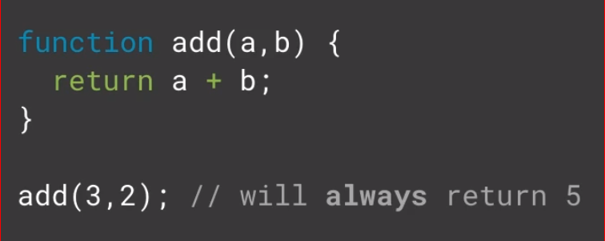
Pure functions

Slide 47
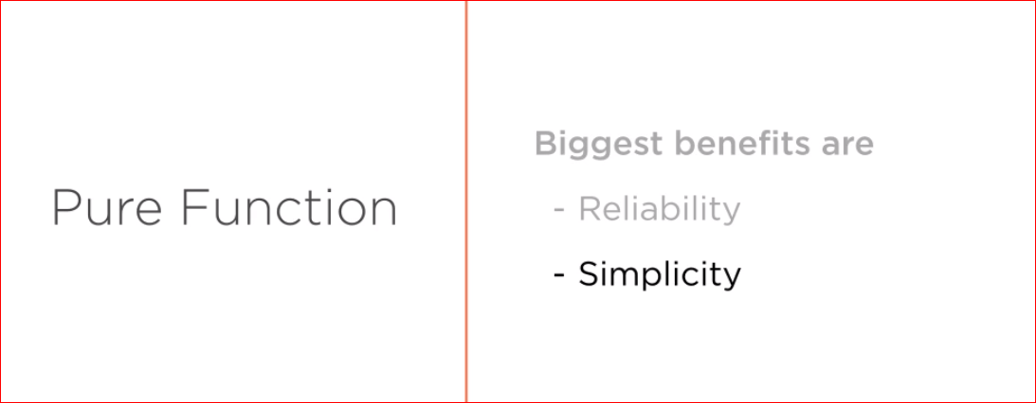

Slide 48
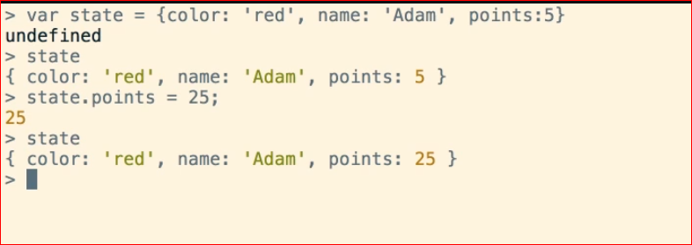
Immutability

Slide 49
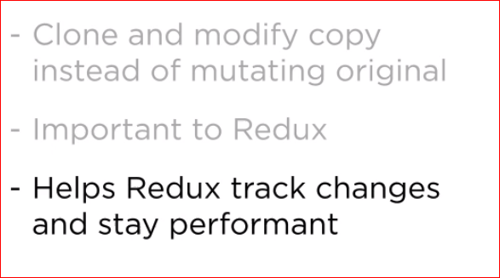
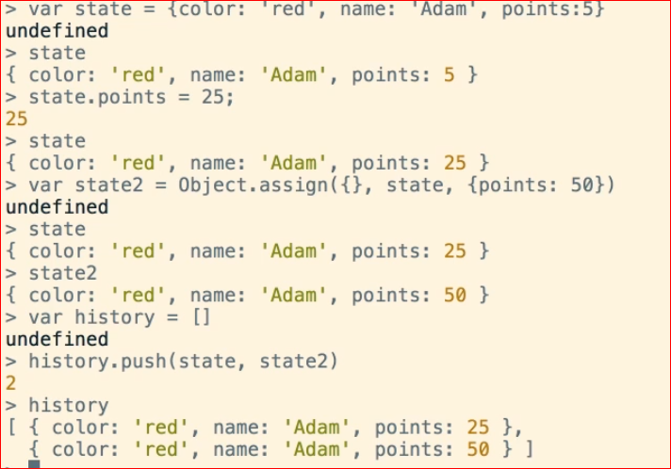
Immutability

Slide 50
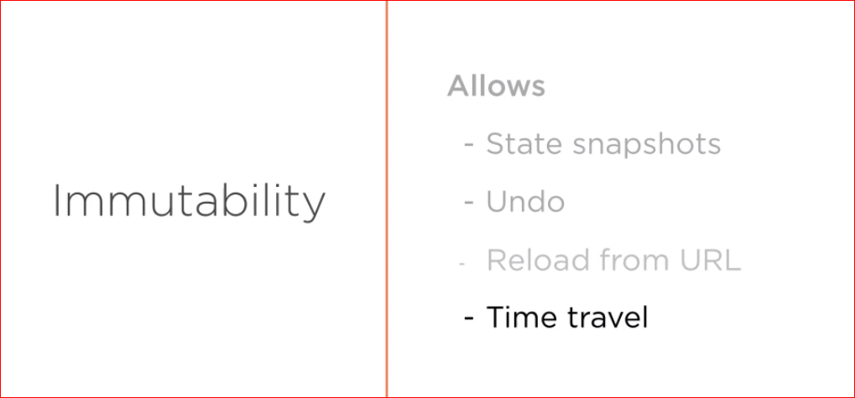

Slide 51
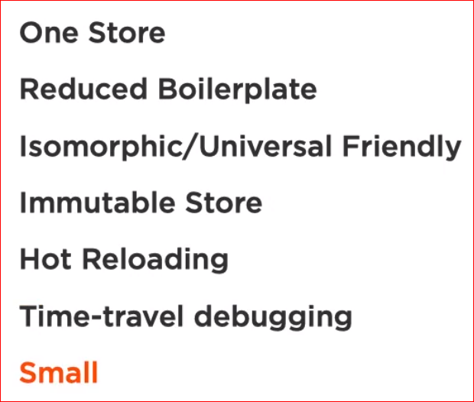
Redux State management library

Slide 52
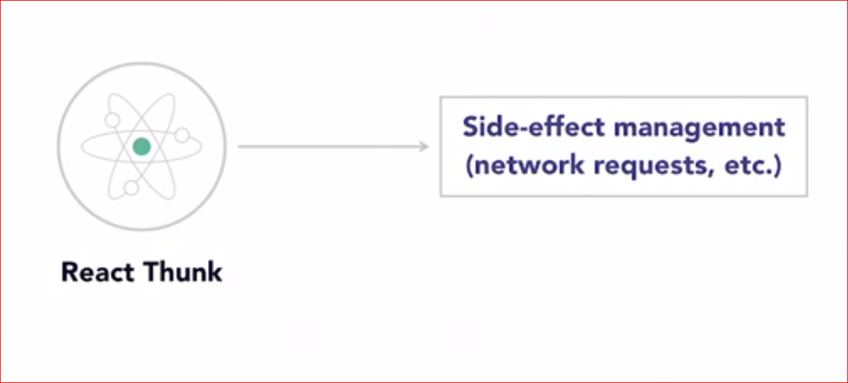

Slide 53
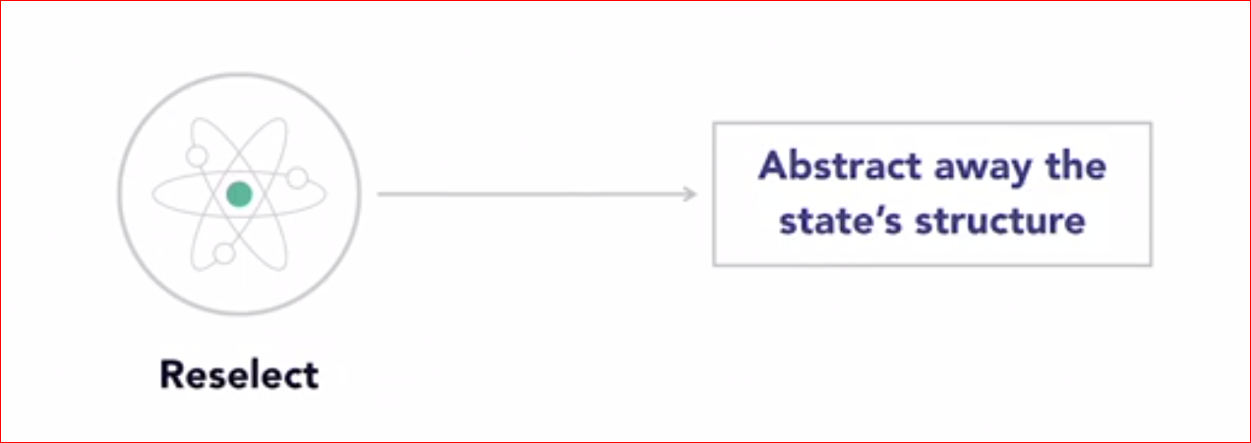

Slide 54
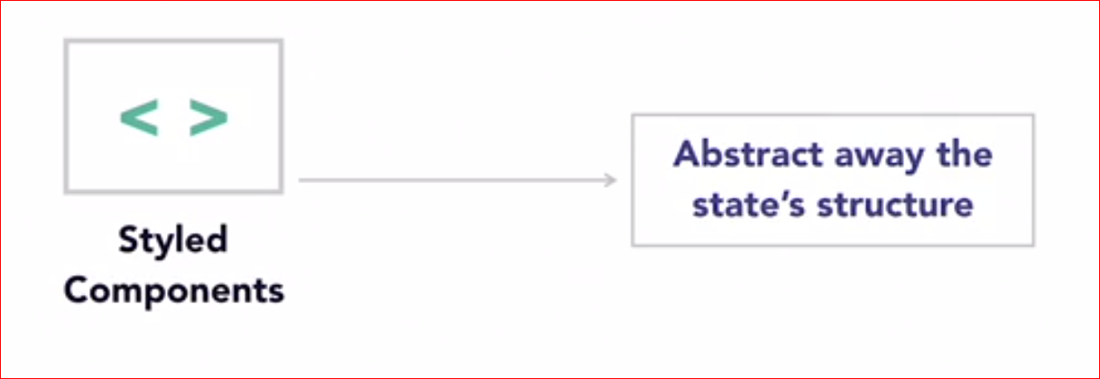

Slide 55
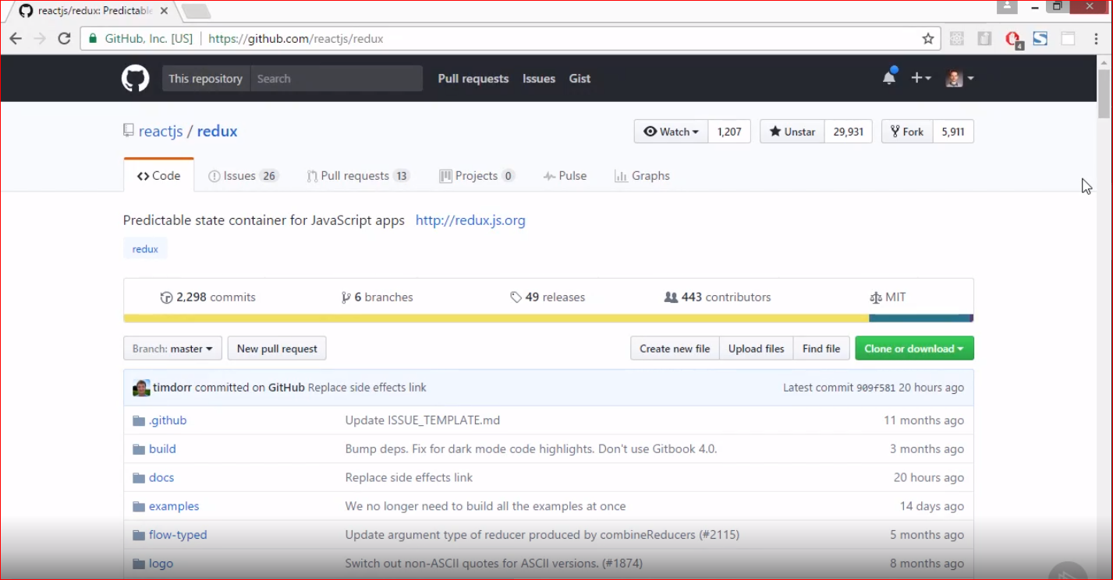

Slide 56
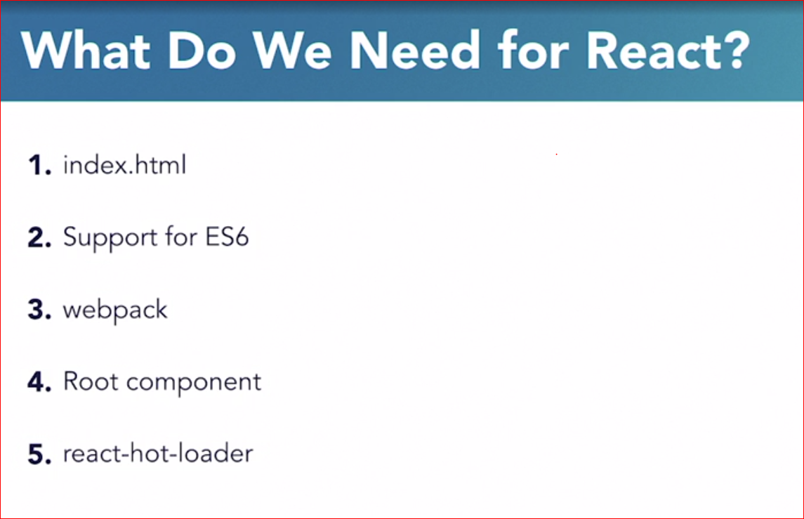

Slide 57
Redux Dev Tool
Store:
export const configureStore = () => createStore(persistedStore,
window.__REDUX_DEVTOOLS_EXTENSION__ &&
window.__REDUX_DEVTOOLS_EXTENSION__());

Slide 58
Persist state in redux
npm install redux-persist
Store:
import {persistReducer} from ‘redux-persist’ import storage from ‘redux-persist/lib/storage’
import autoMergeLevel2 from ‘redux-persist/lib/stateReconciler/autoMergeLevel2’
const persistConfig = {
key: 'root',
storage,
stateReconciler: autoMergeLevel2,
}
const persistedReducer = persistReducer(persistConfig, rootStore);

Slide 59
Persist state in redux
Index:
Import {PersisteGate} from ‘redux-persist/lib/integration/react’
Import {persistStore} from ‘redux-persist’
<PersistGate persistor={persistor} loading={<div>loading</div>}>
<App />
</PersistGate>
permacrash

Slide 60


Slide 61
Commands:
npm init –y
git init
npm install --save-dev @babel/core @babel/cli @babel/preset-env @babel/preset-react
npm install react react-dom
npm install --save-dev webpack webpack-cli webpack-dev-server style-loader css-loader babel-loader
npx webpack-dev-server --mode development
npm install --save-dev react-hot-loader
npm run dev
npm run build
npm install redux react-redux
npm install redux-persist
Why use the React ecosystem? (linkedin.com)

Slide 62


Slide 63


Slide 64


Slide 65


Slide 66


Slide 67


Slide 68
Commands
Disable ssl for local server: chrome://flags/#enable-quic
npm install redux-thunk redux-devtools-extension @babel/runtime
npm install --save-dev @babel/plugin-transform-runtime
.babelrc: “plugins” : [“@babel/plugin-transform-runtime”]
Store.js: import thunk from "redux-thunk";
import { composeWithDevTools } from "redux-devtools-extension";
import { createStore, combineReducers, applyMiddleware } from "redux";
composeWithDevTools(applyMiddleware(thunk))

